Slide 1

COLLEGE OF INFORMATICS AND VIRTUAL EDUCATION
DEGREE PROGRAMME: BACHELOR OF SCIENCE IN COMPUTER ENGINEERING
COURSE NAME: MICROCONTROLLER SYSTEMS.
COURSE CODE: CT 321.
GROUP NUMBER: 6.
GROUP MEMBERS
S/N | NAME | REGISTRATION | PROGRAMM
1 | JUMA HOSENI KOKOTO | T23-03-17324 | BSc-CE
2 | ELIZABETH BERNADO LUCAS | T23-03-01199 | BSc-CE
3 | HAPPINESS ANDREW MAPULI | T22-03-07265 | BSc-CE
4 | GERVAS MATERU | T23-03-11198 | BSc-CE

Slide 2
Real-Time Clock (RTC) Display System using ATmega32 and I2C/TWI Protocol

Slide 3
Project Overview And Objectives
Main Objective
Design, configure, and simulate a digital clock system that reads real-time parameters (Time & Date) from an external I2C RTC peripheral and displays them dynamically on a 16x2 Character LCD.

Slide 4
Core System Components:
Microcontroller: Microchip ATmega32 (8 MHz Internal Oscillator).
Display Module: HD44780 16x2 LCD executing in an Optimized 4-Bit Mode.
Timekeeping Module: Bus-configured I2C Real-Time Clock (RTC) Architecture.

Slide 5
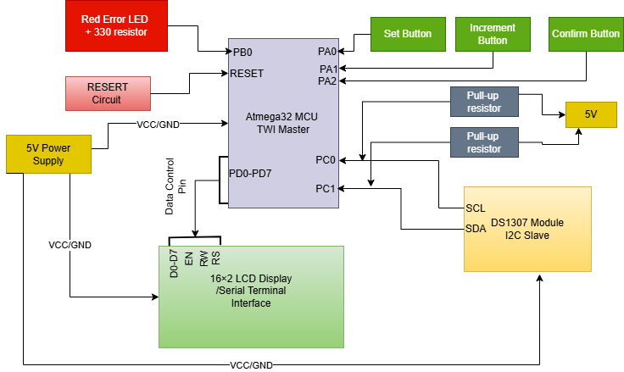
System Block Diagram

Slide 6
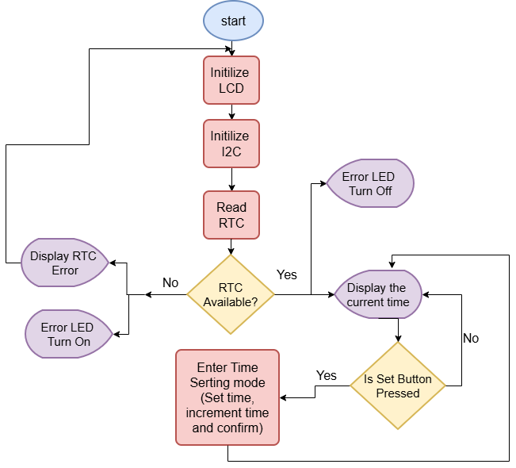
Firmware Flow Chart

Slide 7
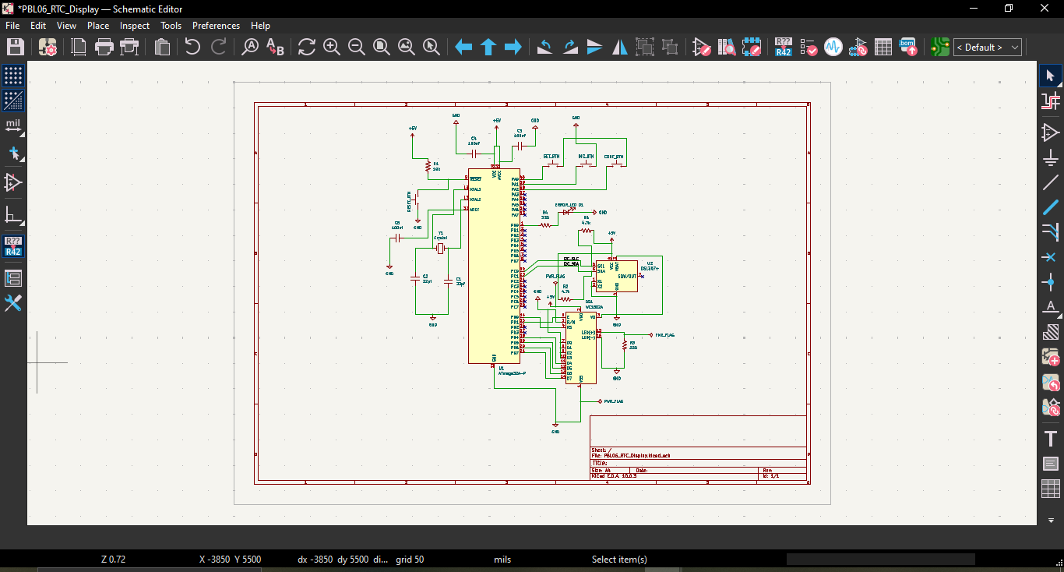
Schematic Diagram For Our System

Slide 8
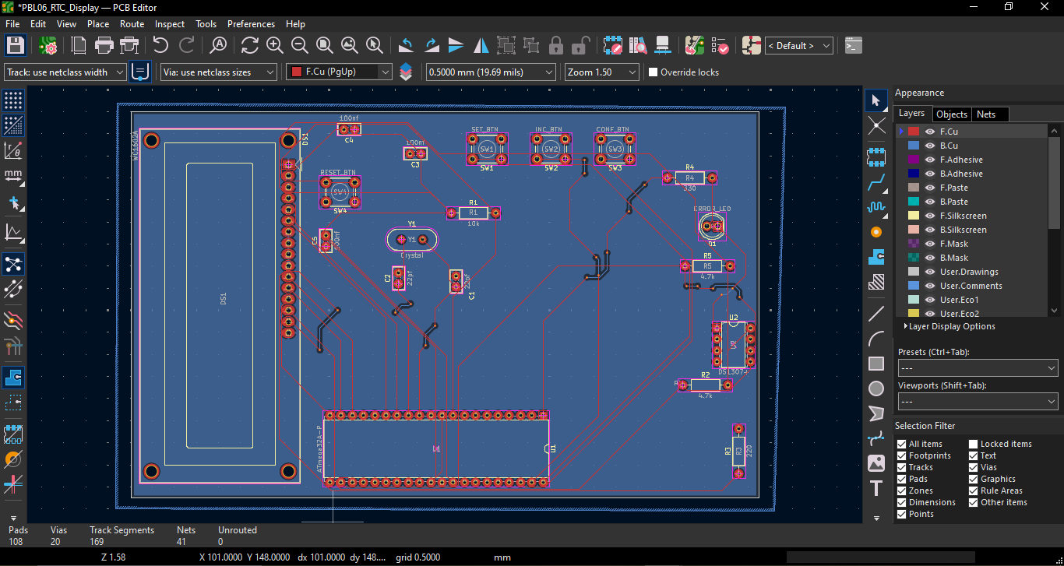
PCB Editor FootPrint

Slide 9
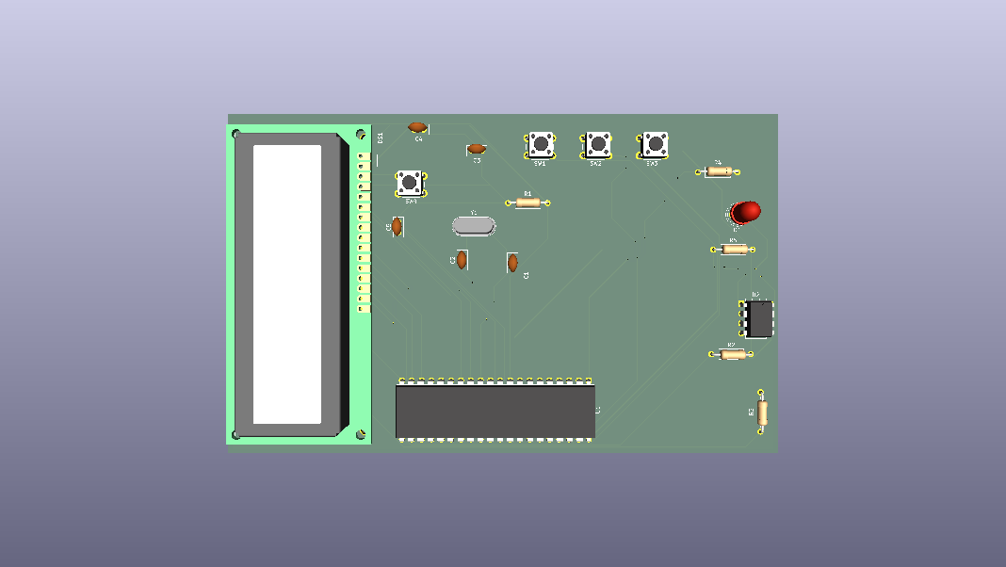
PCB Layout

Slide 10
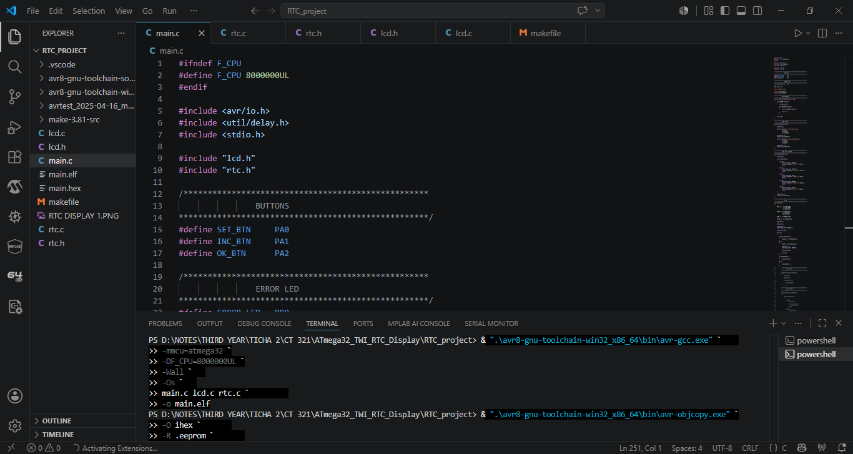
MPLAB For Vs-code

Slide 11
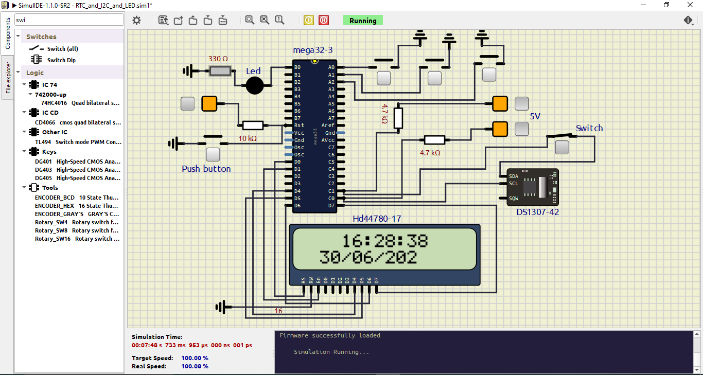
Simulation Execution Diagram

Slide 12
Challenges
LCD wiring
SimulIDE power pins
Reset circuit
AVR compiler configuration
Missing headers
Missing DS1307 library
TWI debugging
Button debouncing

Slide 13
Solutions
Modular programming
Step-by-step testing
Individual module verification

Slide 14
Conclusion
The project successfully developed an embedded real-time clock system using the ATmega32 microcontroller and the DS1307 RTC module. The system accurately reads and displays the current time and date on a 16×2 LCD, allows the user to modify the time through push buttons, stores the updated values in the RTC, and detects communication failures by activating an error LED. The project demonstrates the practical application of I²C communication, modular embedded software design, and hardware interfacing principles.

Slide 15
THANK YOU

